Slide 1
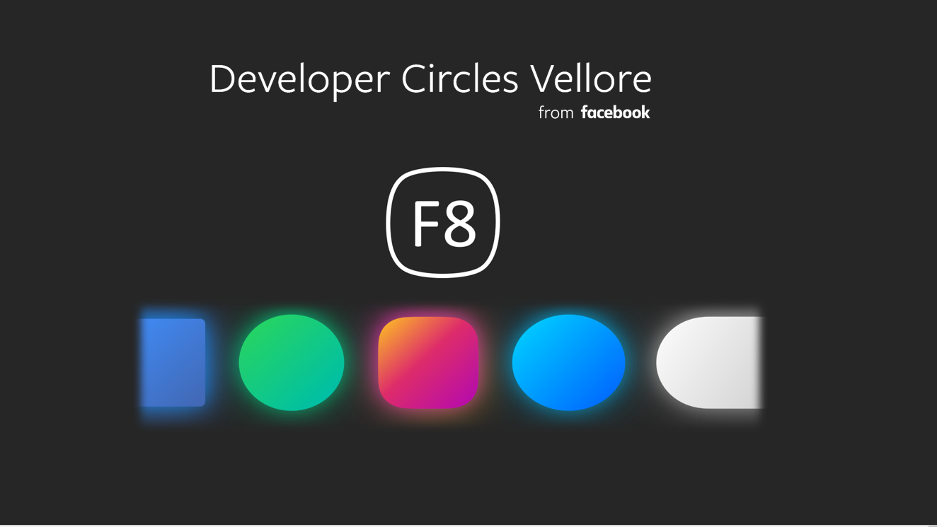

Slide 2


Overview

Slide 3

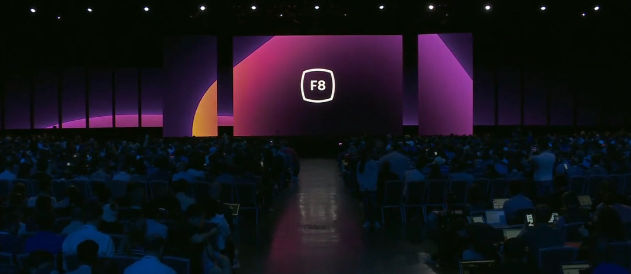
F8 2019
Welcome to Facebook's 10th F8. It is a technical meet-up for developers, creators, entrepreneurs and innovators from all around the world to showcase the upcoming products and services.
F8 Meetups are an exciting way for global Developer Circles communities who aren't physically at F8 to experience it from afar, together. Your Meetup is an opportunity for local developers to network with each other, watch the keynote, and talk about the latest technology from Facebook's family of apps.

Slide 4

About Developer Circle Vellore

Slide 5
Facebook Developer circle Vellore
Facebook Developer Circle is a renowned global network of communities established by developers, for developers. Each of the local communities work with the same motto to help developers reach the zenith of their potential. Vellore is one such local community in Facebook developer circles, which serves as a forum for tech enthusiasts and developers to use Facebook as a platform to build, interact and collaborate with each other.
This is a forum for developers who are interested in building on the Facebook platform to interact and collaborate with other developers. It is a renowned global network of communities established by developers, for developers.
FDC Vellore conducts many events, webinars and sessions in and around Vellore to keep up with its motto.

Slide 6


Past Events

Slide 7


Build Days
The objective of Build Days is to bring together developers and community leaders from across the globe to create solutions that help people build community and bring the world closer together. Participants were asked to create solutions that use at least one Facebook developer product, such as Groups API, Messenger or React
Docker
Docker 101was a hands on workshop about Docker for student of VIT vellore.
The purpose of the workshop was to provide beginners with an insight in the docker
containerisation journey and enable them to start a breath taking voyage.

Slide 8



Docker 101was a hands on workshop about Docker for student of VIT vellore.
The purpose of the workshop was to provide beginners with an insight in the docker
containerisation journey and enable them to start a breath taking voyage.
The purpose of the session was to spread the awareness and familiarise attendees about react concepts
were further employed to build basic introductory apps.
Facebook Developers circle Vellore is conducting this event not only to celebrate the women in tech but also to inspire and encourage more and more women to evolve technically. And to take any challenge as a creative opportunity.

Slide 9

Webinar
Servers
GCP
GitHub
Python
Arduino

Slide 10

Introdction to Cloud
Servers
GitHub
Python
Arduino
GCP

Slide 11
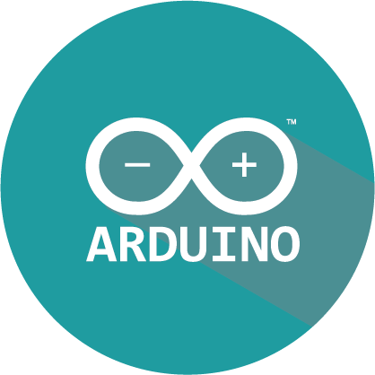
Introdction to Arduino
Servers
GCP
GitHub
Python
Arduino

Slide 12
Networking app using Python
Servers
GCP
GitHub
Python
Arduino

Slide 13

Git And GitHub
GCP
Servers
GitHub
Arduio
Python

Slide 14

Playing with Servers
Servers
GCP
GitHub
Python
Arduino

Slide 15

Our Motive

Slide 16
Spreading knowledge on new tech
Work on different projects
Help in startups : Winuall
Internship opportunities
Scholarship opportunities

Slide 17
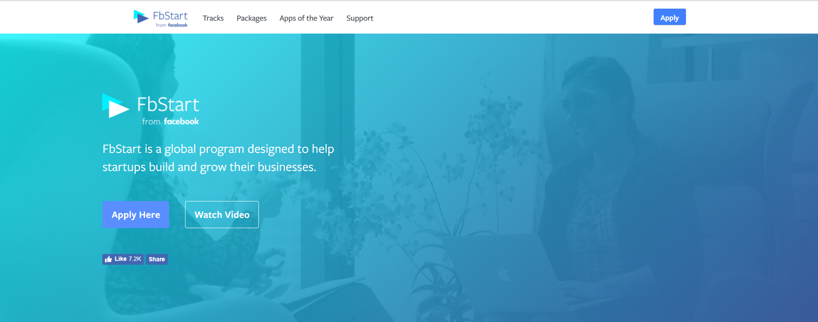
LET US HELP YOUR STARTUP SUCCEED.
FbStart provides year-round technical support from Facebook, an exclusive community of global startups, free credits to tools and services from dozens of premier partners, training on Facebook Developer Tools, and more.

Slide 18

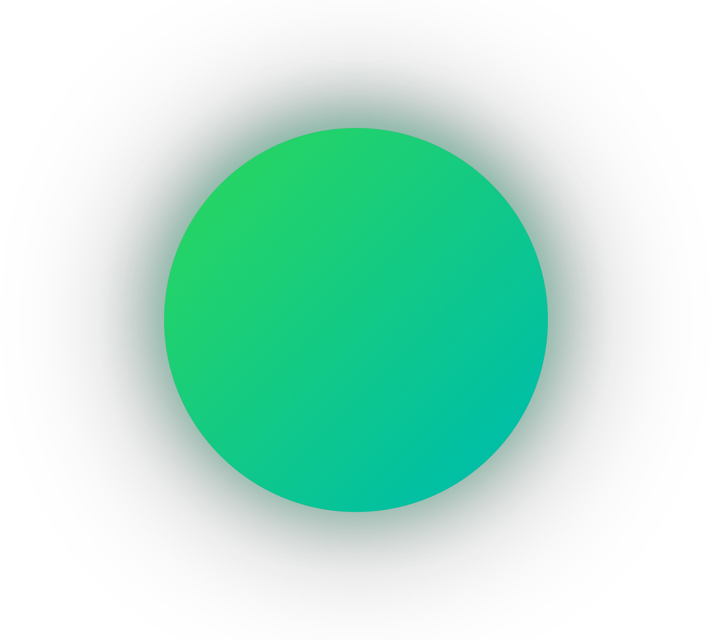




Thank you

